Slide 1
K means Clustering Algorithm Explained With an Example Easiest And Quickest Way Ever

Slide 2
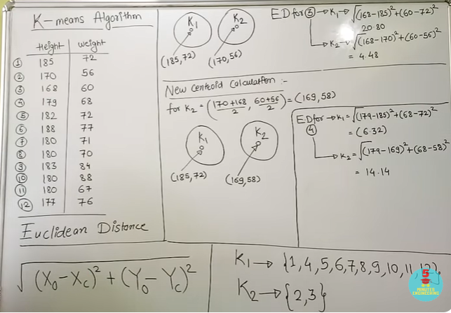
7.21

Slide 3
https://www.youtube.com/watch?v=CLKW6uWJtTc

Slide 4
k-means clustering is a method of vector quantization, originally from signal processing, that aims to partition n observations into k clusters in which each observation belongs to the cluster with the nearest mean (cluster centers or cluster centroid), serving as a prototype of the cluster.

Slide 5
K-Nearest Neighbor Classification ll KNN Classification Explained with Solved Example

Slide 6
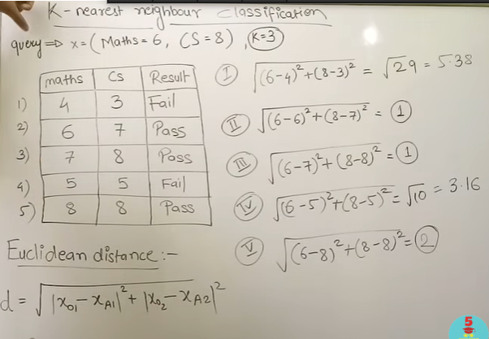

Slide 7
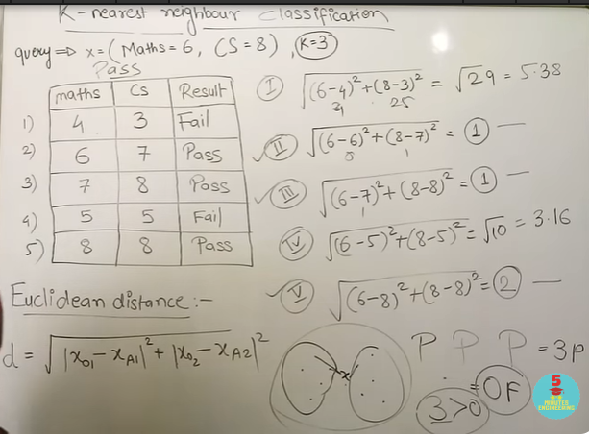

Slide 8
https://www.youtube.com/watch?v=CJjSPCslxqQ

